Slide 1
Deep Q-Learning Sample Efficiency and Policy with 2048
By Jamie Voynow

Slide 2
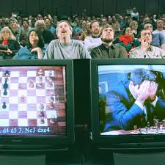

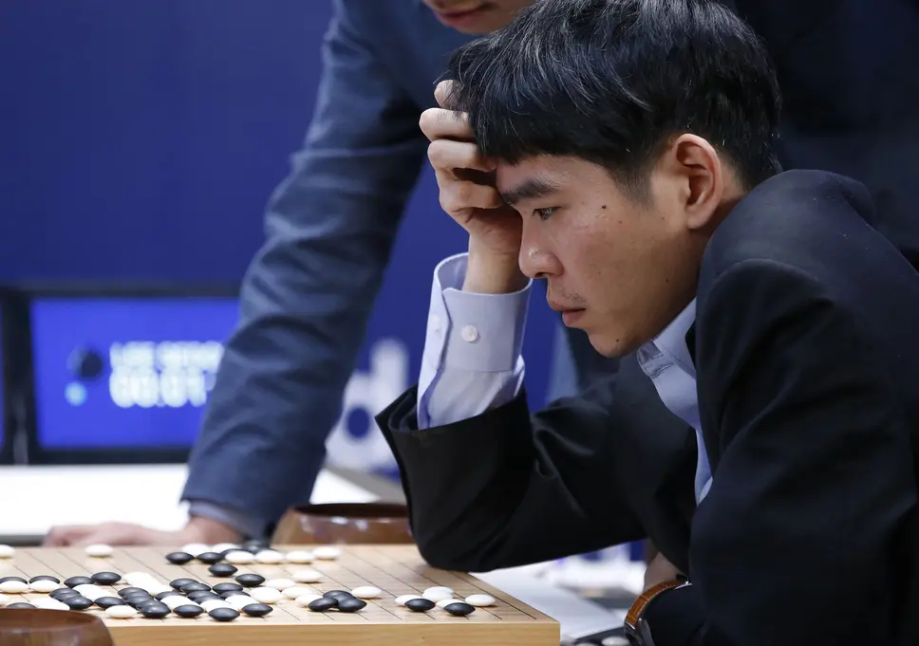

Motivation

Slide 3
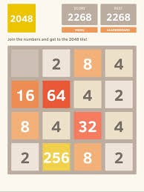
2048
An “environment” to perform RL experiments
Contains distinct differences from classical RL environments
Let’s Play: https://play2048.co/

Slide 4
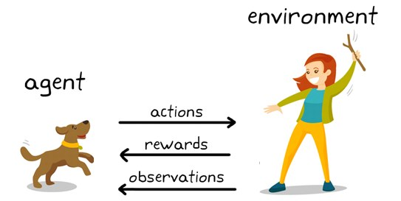
Reinforcement Learning
Definition:
“...how software agents ought to take actions in an environment in order to maximize the notion of cumulative reward.”
Formally defined by:
agent
environment
state
action
reward

Slide 5
Deep Q-Learning (DQN)
Replay Memory
Epsilon Greedy Exploration
Bellman Equation
Repeat for n games for all Iterations
While not game_over:
-Take action
-Save action, reward, state transition
Train on Replay Memory

Slide 6
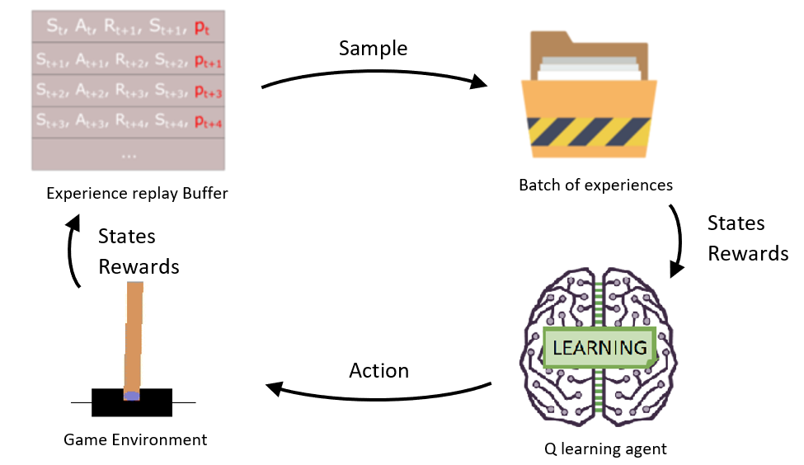
Replay Memory
(s_{t}, a_{t}, r_{t+1}, s_{t+1})

Slide 7

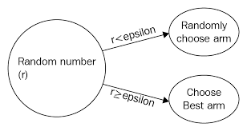
Epsilon Greedy Exploration
ε = 1
for all iterations:
ε -= iterations⁻¹
Note: minimum epsilon used in practice

Slide 8
Bellman Equation (how we train)
q(s_{t}, a) = E[r_{t+1} + γ max q*(s_{t+1}, a)]
Input
output
State (s_{t})
-> q*(s_{t}, a₀)
-> q*(s_{t}, a₁)
-> q*(s_{t}, a₂)
-> q*(s_{t}, a_{n})
Loss = q*(s, a) - q(s, a)

Slide 9

DQN -> DDQN
Let’s talk some more about the Bellman Equation
q(s, a) = E[r_{t+1} + γ max q*(s_{t+1},a)]
def update_network(agent, target):
target.set_weights(agent.get_weights())
if iteration % iter_per_update == 0:
update_network(agent, target)

Slide 10
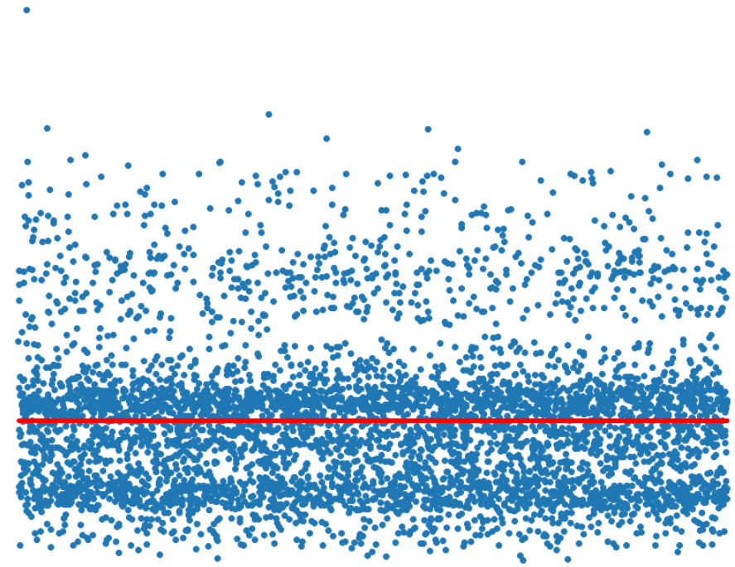
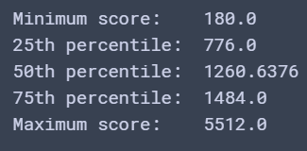
Baseline Results

Slide 11
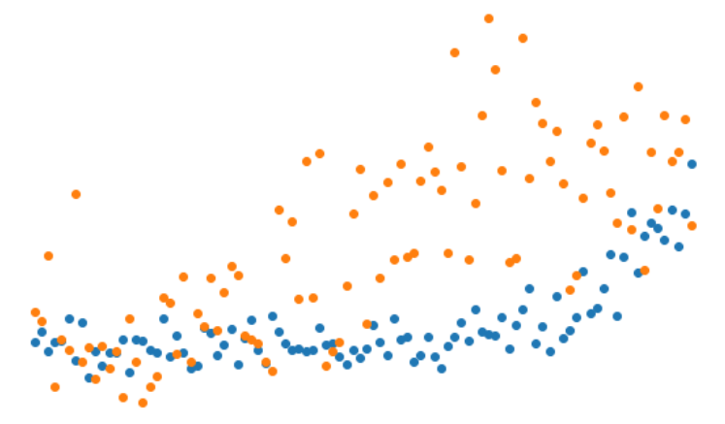
DQN Results
Average Score | Standard Deviation | Training Length
2464 | 1161 | 400 (s)
2516 | 1136 | 405 (s)
2543 | 1144 | 472 (s)
2565 | 1168 | 521 (s)
2485 | 1143 | 499 (s)
2512.8 | 1150.4 | 7.66 (min)
game scores with ε = 0
game scores with ε greedy
Score
Iteration

Slide 12
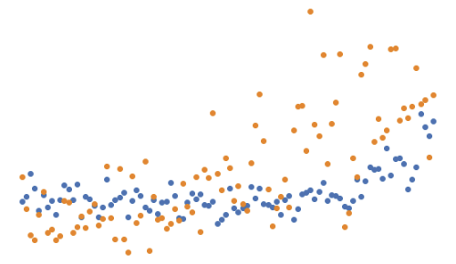
DDQN Results
Average Score | Standard Deviation | Training Length
2792 | 1031 | 401 (s)
2779 | 993 | 514 (s)
2548 | 1161 | 536 (s)
2786 | 1018 | 567 (s)
2636 | 1255 | 558 (s)
2708.2 | 1091.6 | 8.59 (min)
game scores with ε = 0
game scores with ε greedy
Score
Iteration

Slide 13
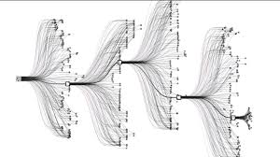
Is there room for improvement?
Uniqueness of 2048 environment
Let us look back at our learning curve

Slide 14
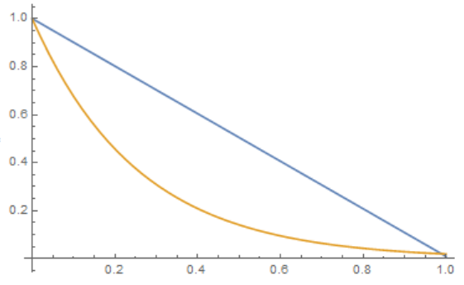
Introducing: Exponential Decay
ε = 1
for all iterations:
ε -= iterations⁻¹
for all iterations:
ε = ε _{min} ** iteration

Slide 15
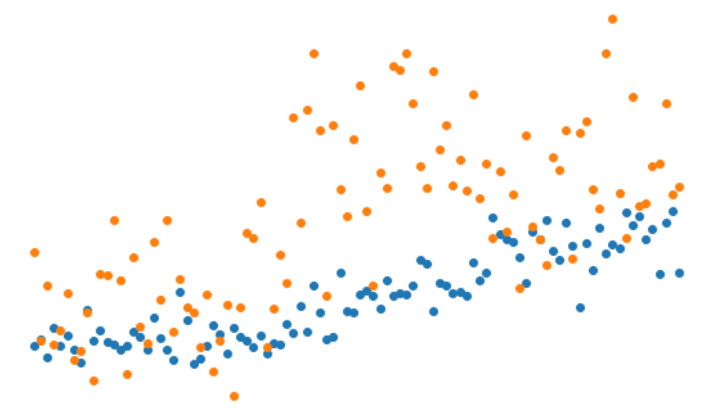
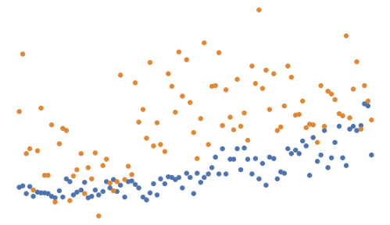
DQN - Exponential Epsilon Decay
Average Score | Standard Deviation | Training Length
2477 | 1128 | 542 (s)
2567 | 1155 | 539 (s)
2615 | 1157 | 555 (s)
2574 | 1150 | 606 (s)
2480 | 1134 | 597 (s)
2542.6 | 1144.8 | 9.46 (min)
game scores with ε = 0
game scores with ε greedy
Score
Iteration

Slide 16
DDQN - Exponential Epsilon Decay
Average Score | Standard Deviation | Training Length
2760 | 1014 | 467 (s)
2865 | 1009 | 552 (s)
2781 | 991 | 628 (s)
2950 | 1106 | 580 (s)
2933 | 1000 | 608 (s)
2857.8 | 1024 | 9.45 (min)
game scores with ε = 0
game scores with ε greedy
Score
Iteration

Slide 17
Conclusions
 | Average | Standard Deviation
DQN - Linear ε Decay | 2512.8 | 1150.4
DQN - Exponential ε Decay | 2542.6 | 1144.8
DDQN - Linear ε Decay | 2708.2 | 1091.6
DDQN - Exponential ε Decay | 2857.8 | 1024

